Slide 1

NYC TAXI DEMAND PREDICTION Mini Project 3 Sang Don Lee 31/10/2020

Slide 2
AGENDA
Business Question
Project Pipeline
Dataset
Modelling
Summary, Conclusions
Visualisation

Slide 3

Business Question
How do we predict the taxi demands
to improve taxi operation
based on the given data?

Slide 4
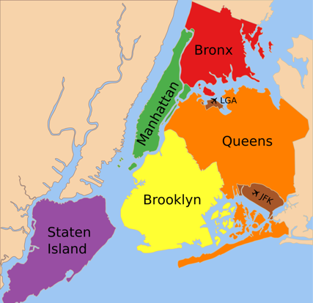
New York City Boroughs Map
NYC Taxi Types
Yellow Taxies
Anywhere from 5 boroughs
Green Taxies
Upper Manhattan
Bronx
Brooklyn
Queens (excl. LGA, JFKIA)
Notes:
LGA: LaGuardia Airport,
JFKIA: John F. Kennedy International Airport

Slide 5
AGENDA
Business Question
Project Pipeline
Dataset
Visualisation
Modelling
Outcome

Slide 6






Project Pipeline
Data
Collection
Wrangling
EDA
Feature Eng
Data
Anlysis
Visualisation
Build
MODELs
Evaluation
IDEAs

Slide 7
AGENDA
Business Question
Project Pipeline
Dataset
Visualisation
Modelling
Outcome

Slide 8

Dataset
Data source
GCP Big Query Database
bigquery-public-data.new_york_taxi_trips.tlc_yellow_trips_2015 & 2016
bigquery-public-data.geo_us_boundaries.zip_codes
Extracted specific features using SQL joining tables and BQ functions
Geo Metric conversation from zip_codes (geopandas)
Kaggle
Historical hourly weather data
Extracting NY only for year 2015 and 2016
https://www.kaggle.com/selfishgene/historical-hourly-weather-data
Data merge and concatenation
Taxi data + weather data concatenated

Slide 9
AGENDA
Business Question
Project Pipeline
Dataset
Visualisation
Modelling
Outcome

Slide 10
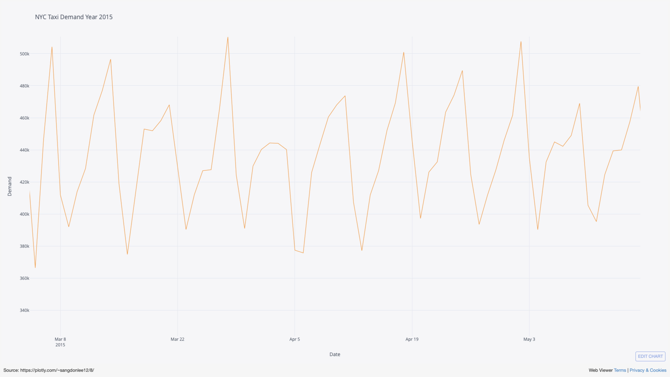

Slide 11
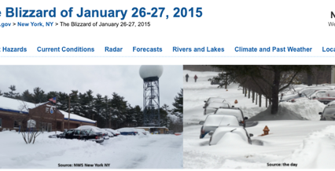


What happened??
26-27/January/2015
Blizzard
4/July/2015
NYC Fireworks
26/Nov/2015
Thanksgiving Day Parade

Slide 12
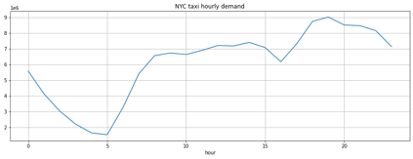
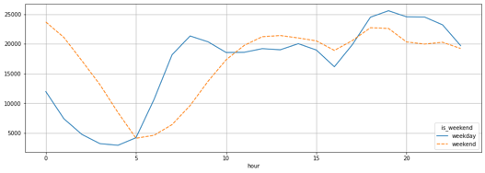
Hourly Demand Weekend is matter?
Patterns?

Slide 13
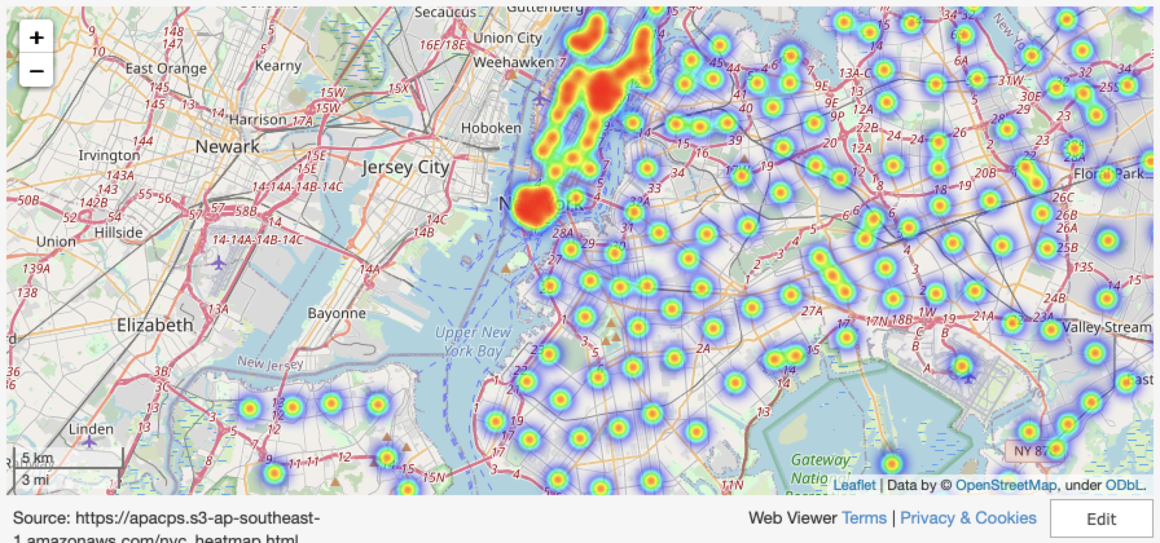
Pickup Area Heatmap

Slide 14
AGENDA
Business Question
Project Pipeline
Dataset
Visualisation
Modelling
Outcome

Slide 15
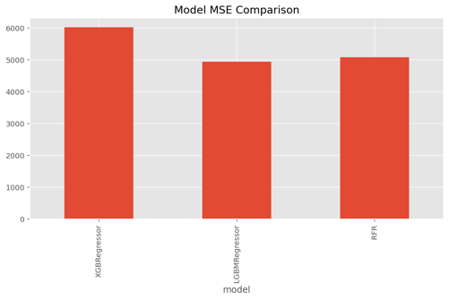
Models
XGBRegressor
LGBMRegressor
RandomForestRegressor

Slide 16
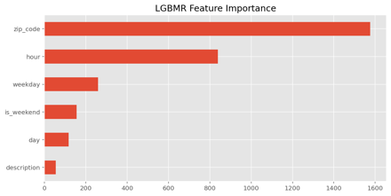
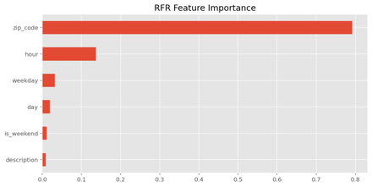
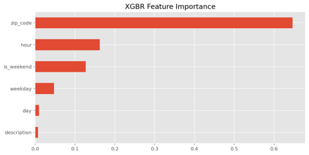
Feature Imporatance

Slide 17
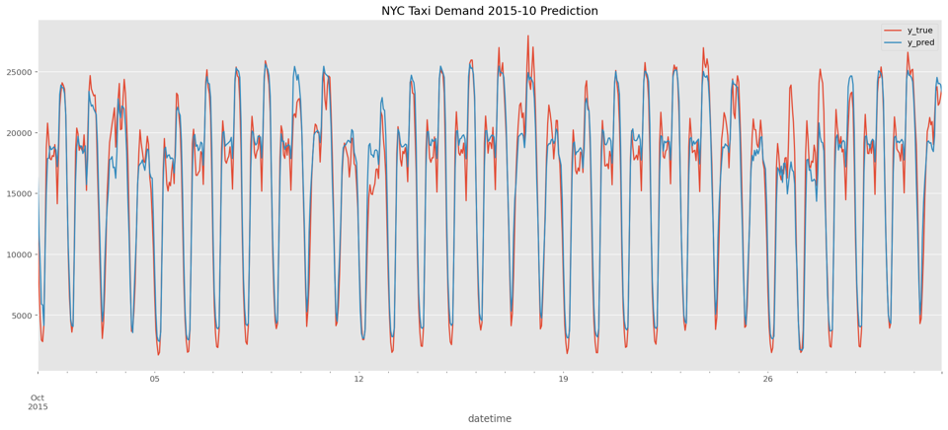
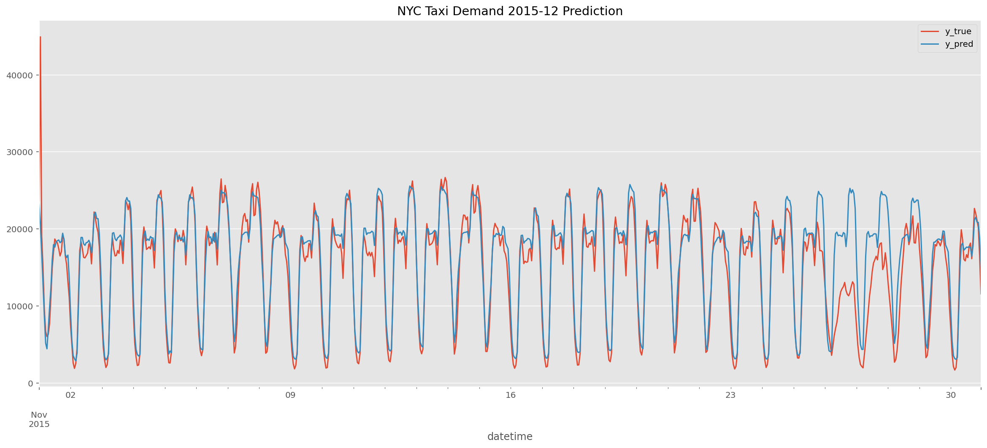
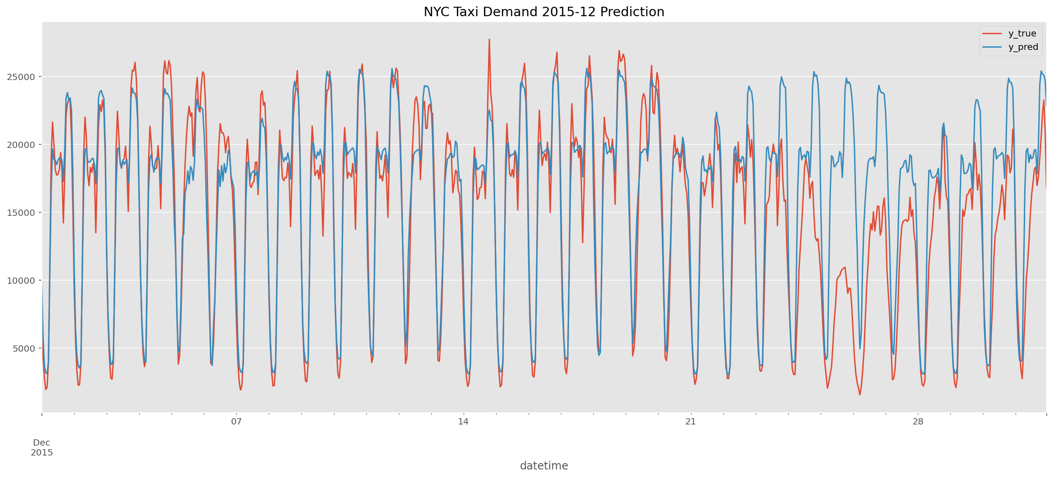
Prediction vs True

Slide 18
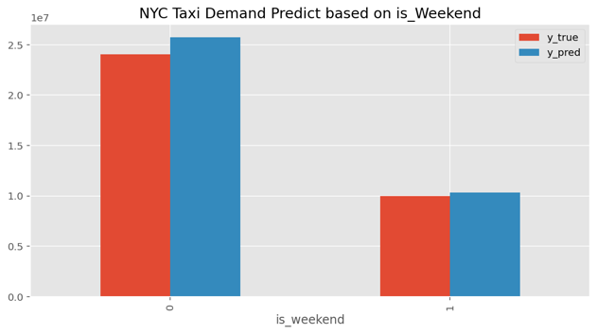
Week or Weekend?

Slide 19
AGENDA
Business Question
Project Pipeline
Dataset
Visualisation
Modelling
Summary Conclusions

Slide 20
Summary
Data
14,612,989 rows
Using SQL, group them into hour segment and count
8760 rows (24hr x 365 days)
Extract zip_code
GeoMetric for heatmap
Weather hourly data
Features
Mapped Zip_Code data
LabelEncoded
Weather Description
sky is clear
overcast coluds
etc
total 36 categories
LabelEncoded
is_weekend
weekday
hour
day
Outcomes
LightGBMRegressor performed the best
Lowest MSE
Predicted captures more demands then True
Not predicting annual events
Next Steps
Apply RNN (LSTM)
Trip Distance
Fare

Slide 21

THANK YOU

